Slide 1
Trends in sulphur and nitrogen components
Is there a consistent picture of model, observations and emissions?

Slide 2
Model set-up
Domain: EECCA, 50km
Meteorological data: ECMWF reanalysis
  1990-2012
Emissions:ECLIPSEv5a (every 5th year)
Ship emissions: MACCIII/TNO 2000-2011, scaled backwards from 2000(-2.5%yr⁻¹)
Mann-Kendall statistical analysis for every grid point
Comparison of model and measurements using the benchmark data set
Preliminary results

Slide 3
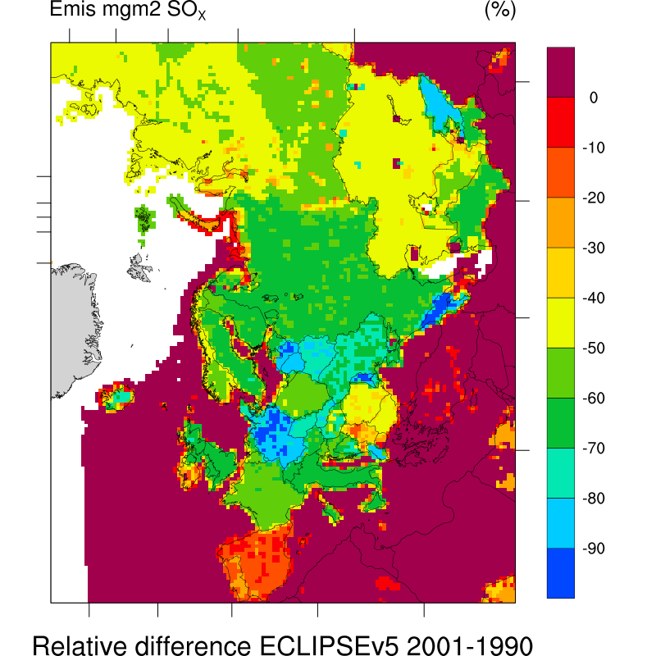
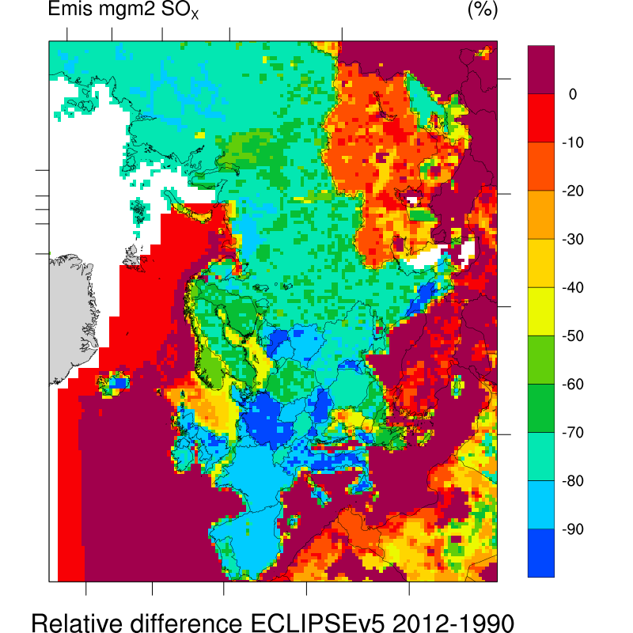
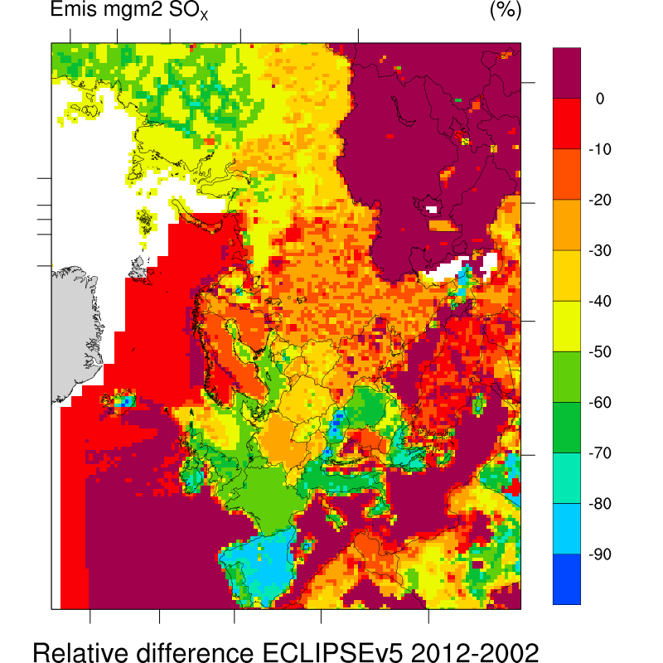
Trends in SOx emissions

Slide 4
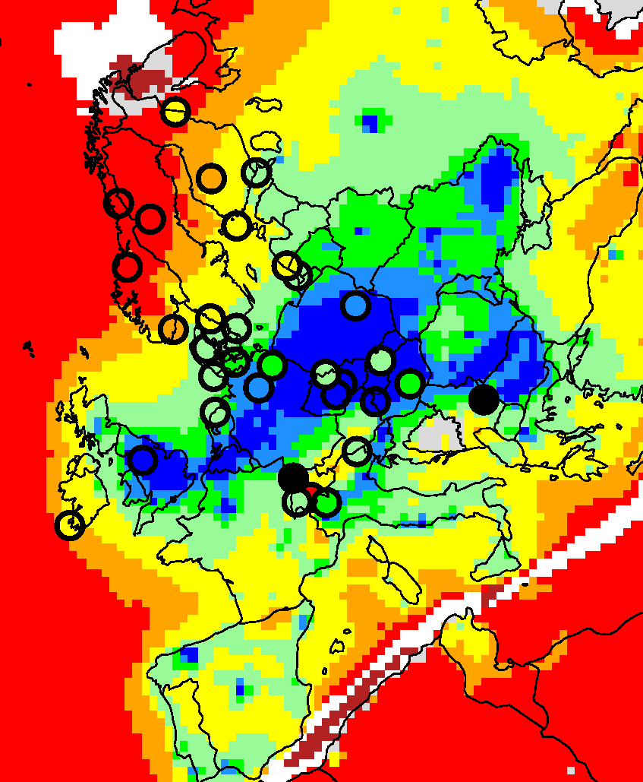

SO₂ (Sen slope: ugS/m³ per year), 1990-2012
Field: model
Circle:observations
Black circle: not significant
trend
 | OBS | MOD
90-12(%yr⁻¹) | -3.8 | -4.1
90-01(%yr⁻¹) | -6.7 | -6.7
02-12(%yr⁻¹) | -4.2 | -5.4

Slide 5

SO2 (Sen slope: % per year), 1990-2012
Percent change (per year) per station – obs vs mod
Not significant

Slide 6
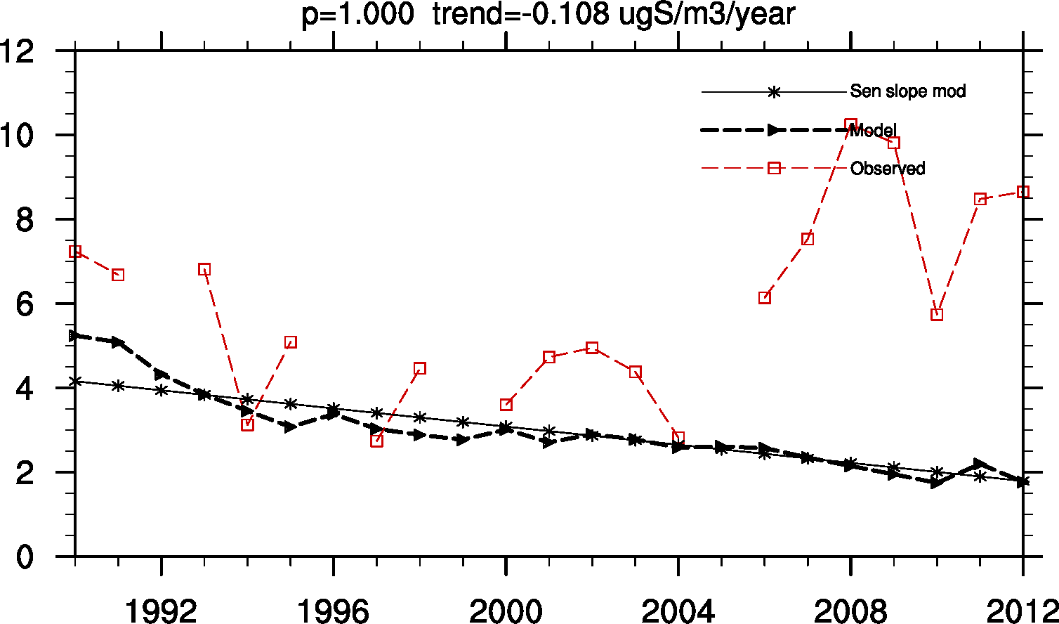
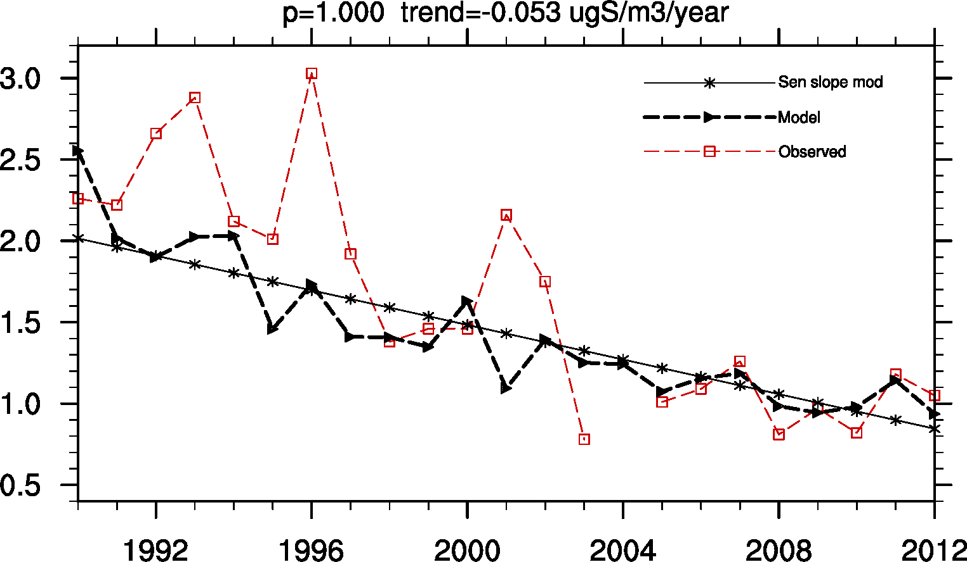
RS05
SO2
S conc. in precip
Unit problem in the data set? Other explanation?

Slide 7
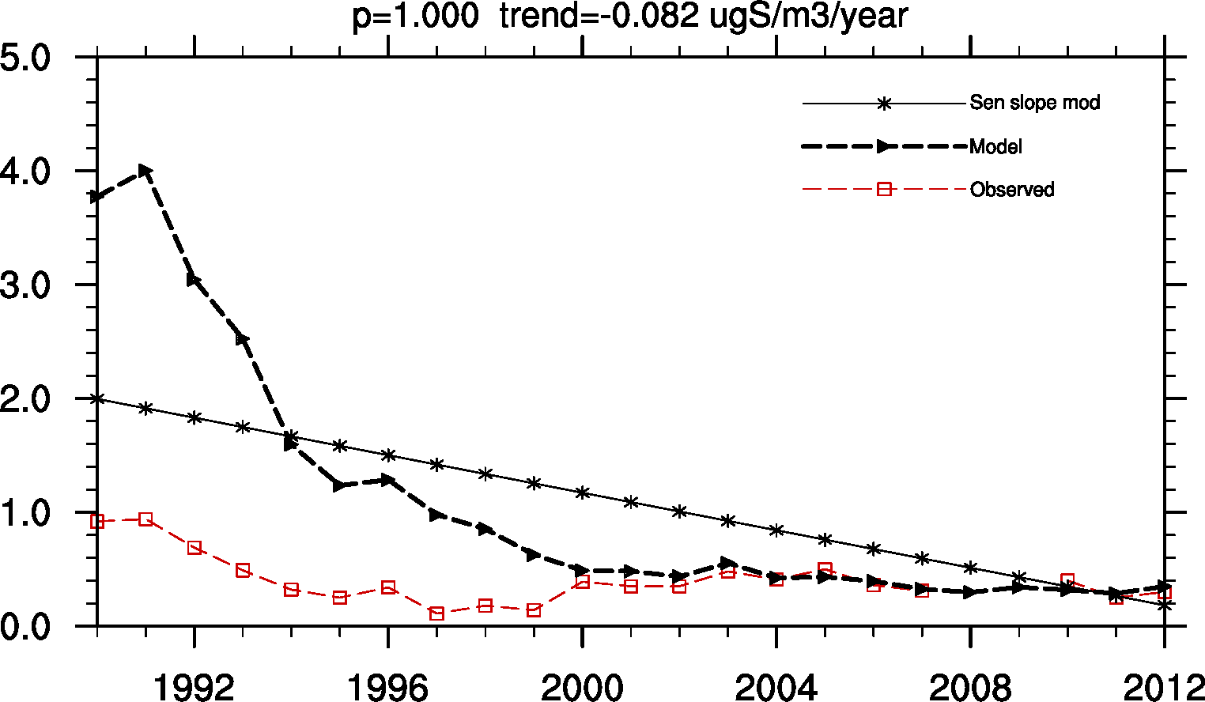
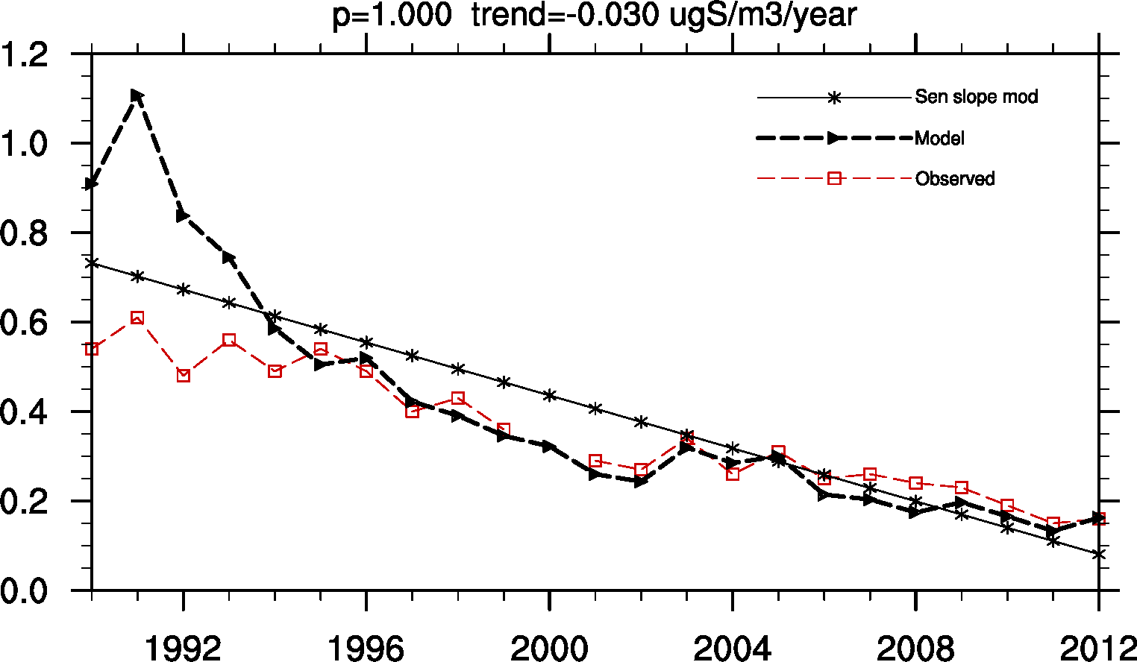
DE03, Schauinsland, 1205m.a.s
SO2
S conc. in precip

Slide 8
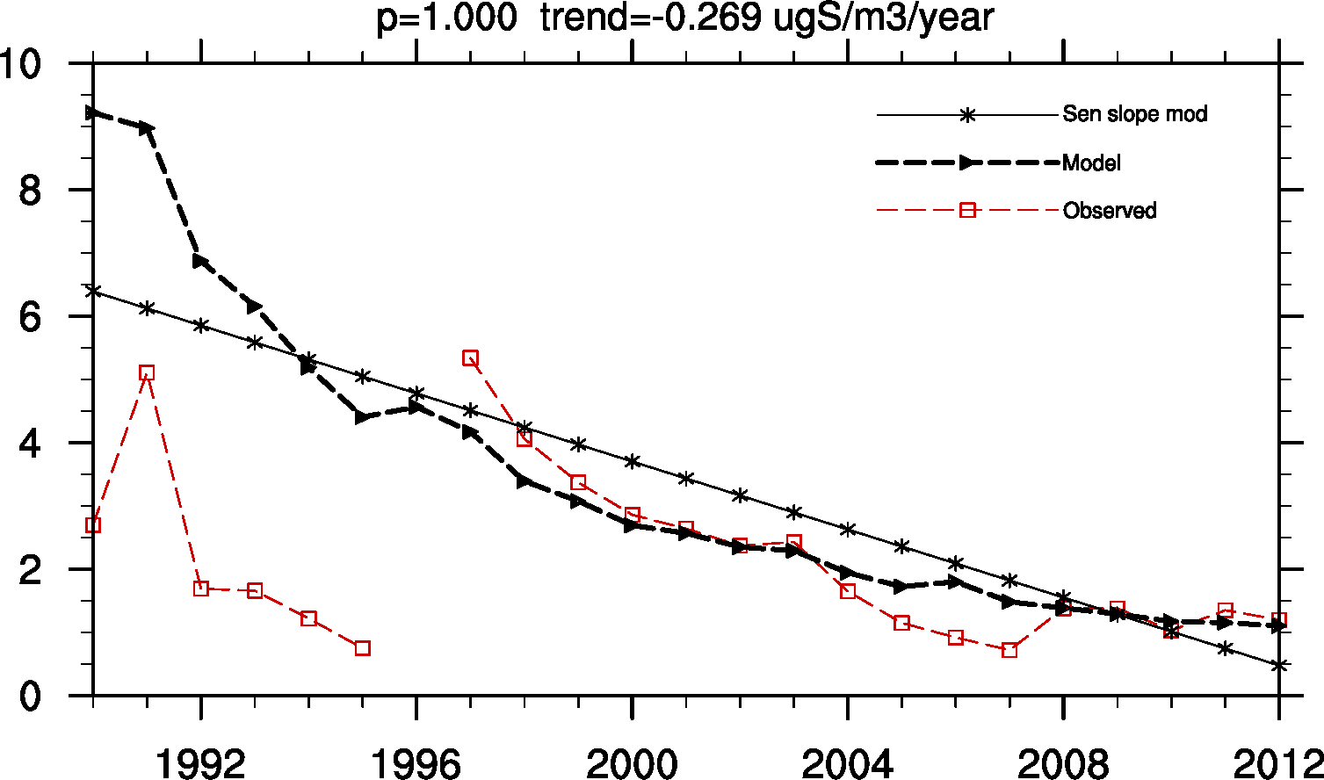
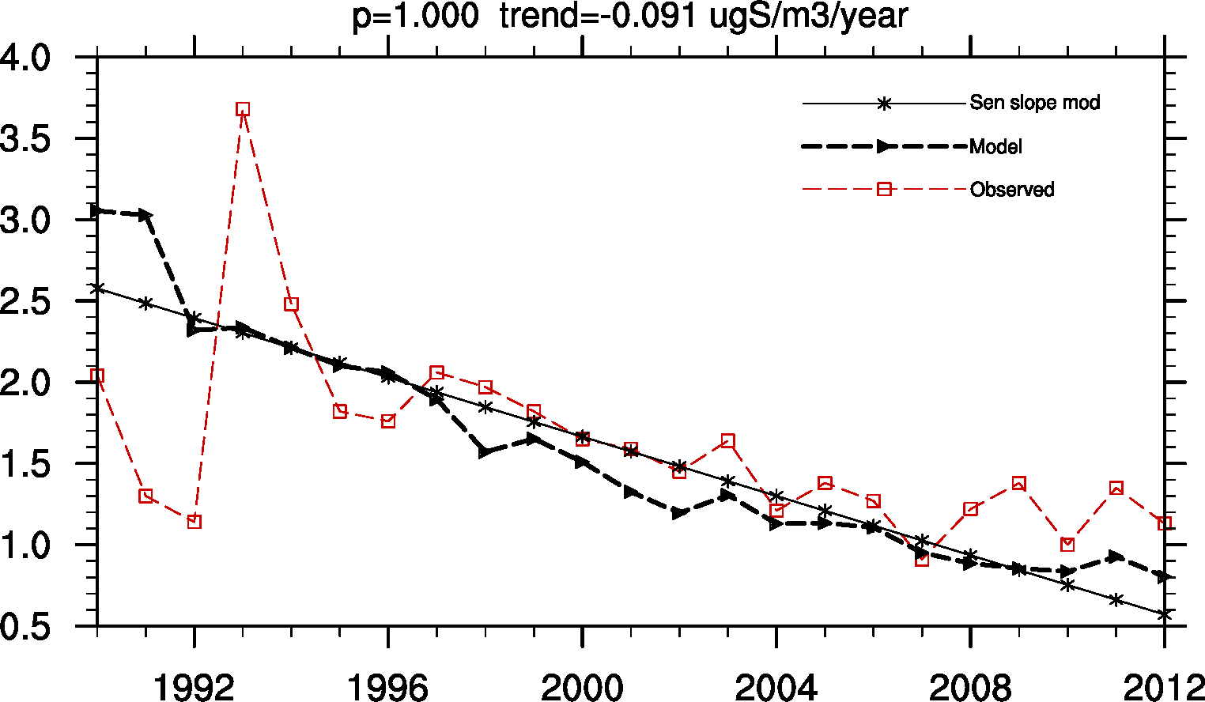
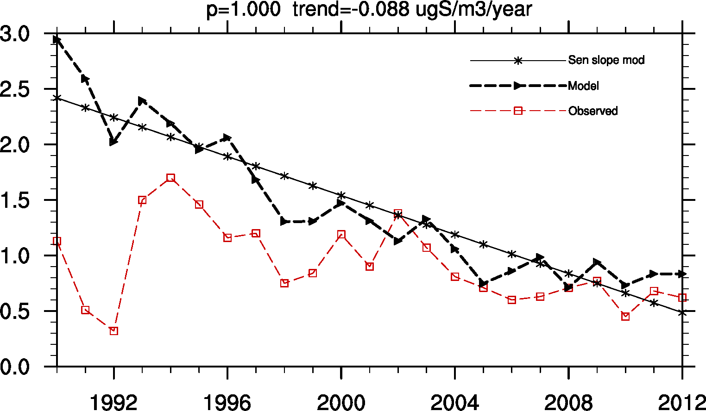
HU02
SO2
SO2
SO4
S conc. in precip

Slide 9
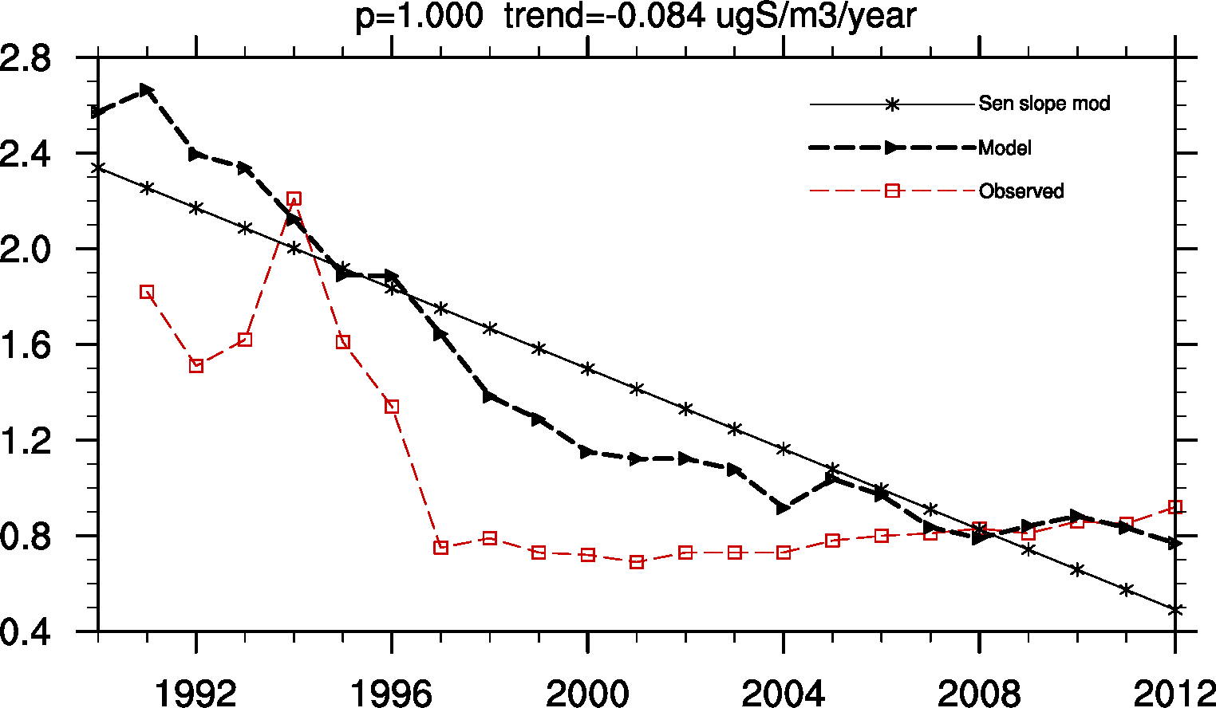
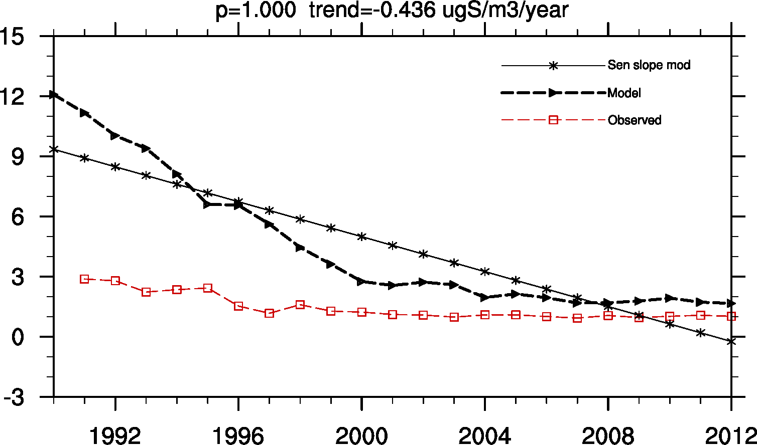
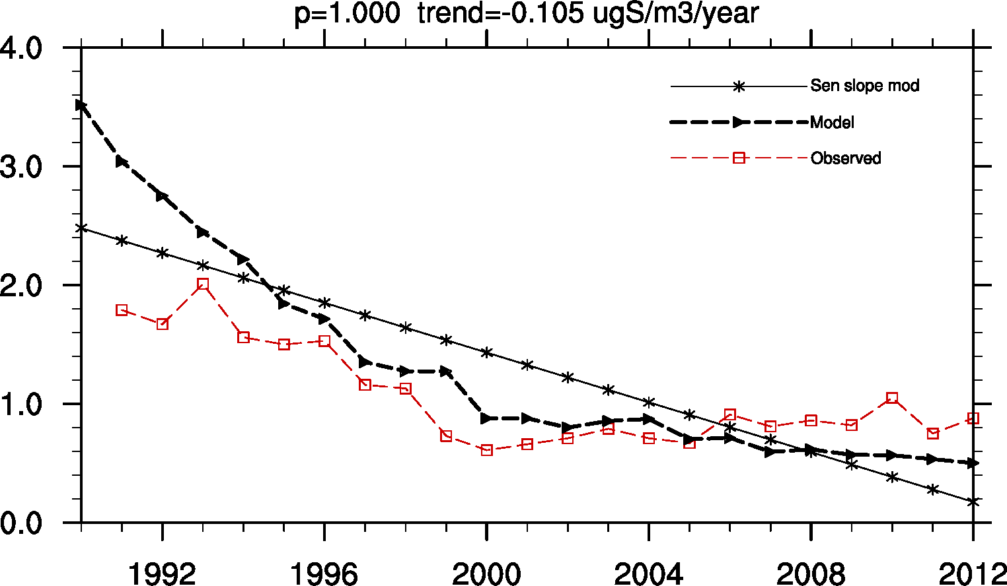
PL03, Sniezka 1603m.a.s
SO4
SO2
S conc in precip

Slide 10
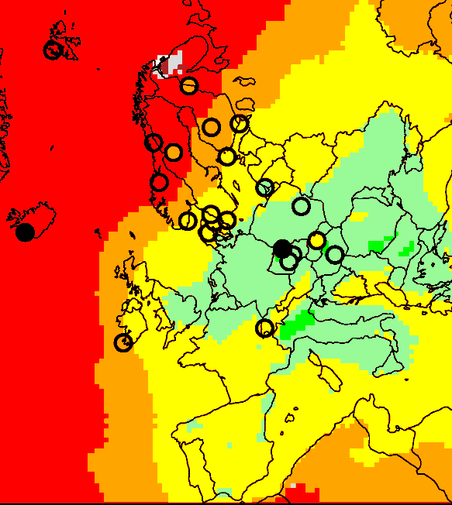

SO4
SO4 (Sen slope: ugS/m3 per year), 1990-2012
 | OBS | MOD
1990-2012(%yr⁻¹) | -2.6 | -3.2
1990-2001(%yr⁻¹) | -4.4 | -4.8
2002-1012(%yr⁻¹) | -3.2 | -4.3
Model slightly larger trend

Slide 11
SO4 (Sen slope: % per year), 1990-2012
Not significant

Slide 12
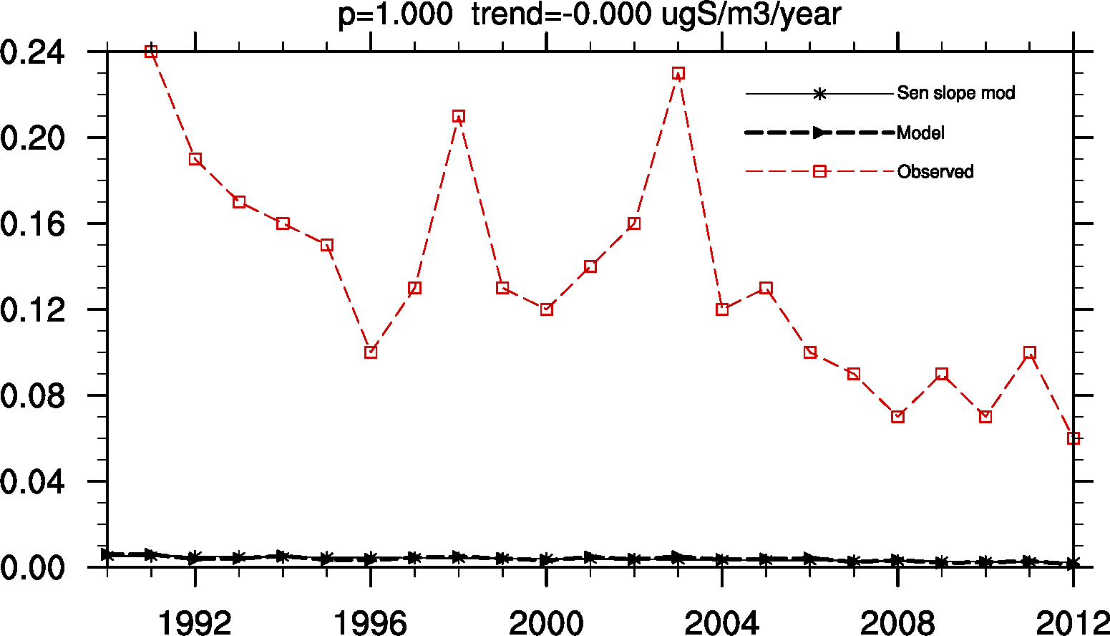
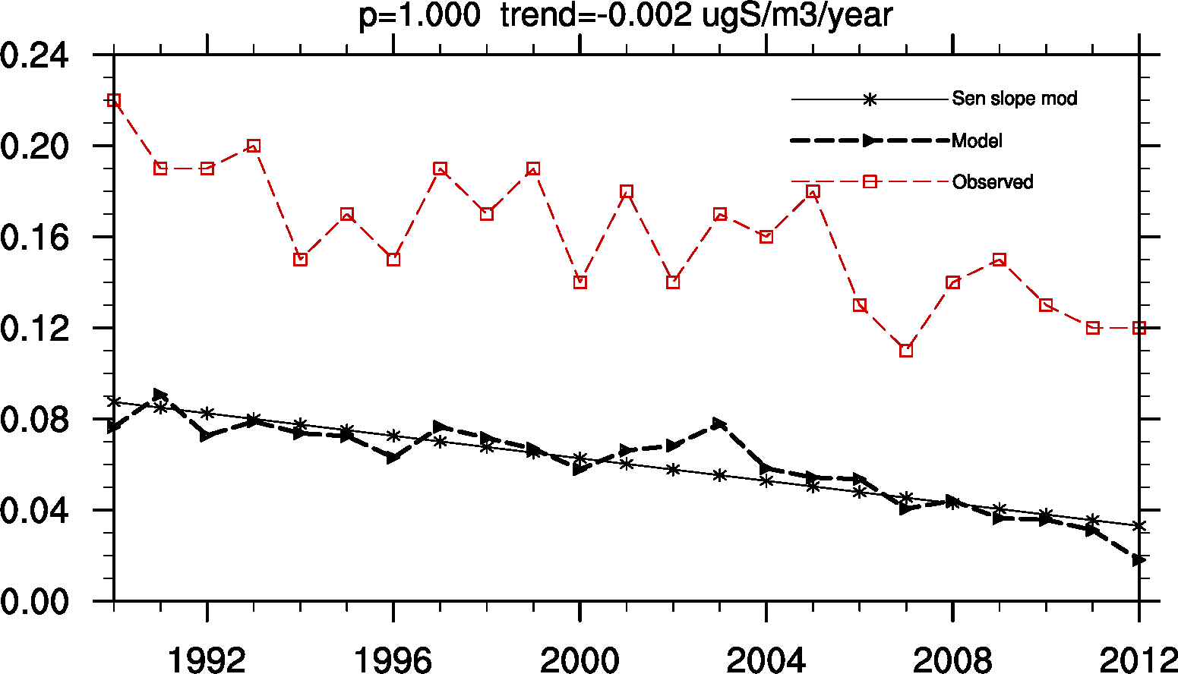
NO42 Zeppelin mountain (Svalbard)
SO2
SO4

Slide 13
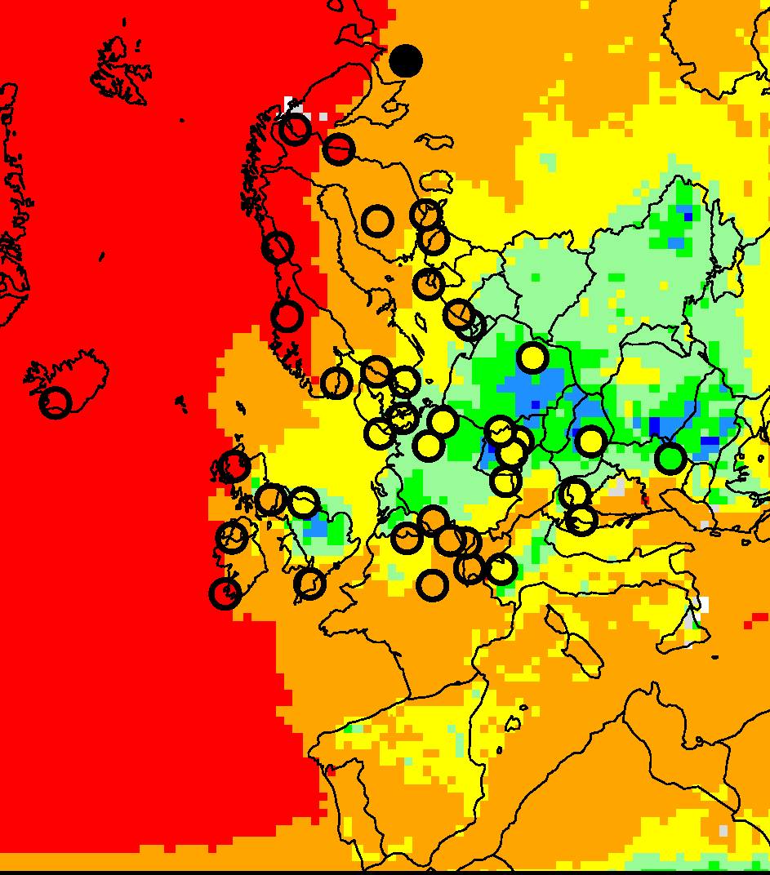

S in precip (Sen slope: mgS/l per year), 1990-2012
 | OBS | MOD
90-12(%yr⁻¹) | -3.1 | -3.8
90-01(%yr⁻¹) | -3.8 | -5.5
02-12(%yr⁻¹) | -4.4 | -5.1

Slide 14
S in precip (Sen slope: % per year), 1990-2012

Slide 15
Summary sulphur
Trends found for all periods (but much fewer for the shorter periods)
Good agreement for SO₂ and SO₄ and model
Somewhat larger modelled trend (ca 20%) for S in precipitation

Slide 16
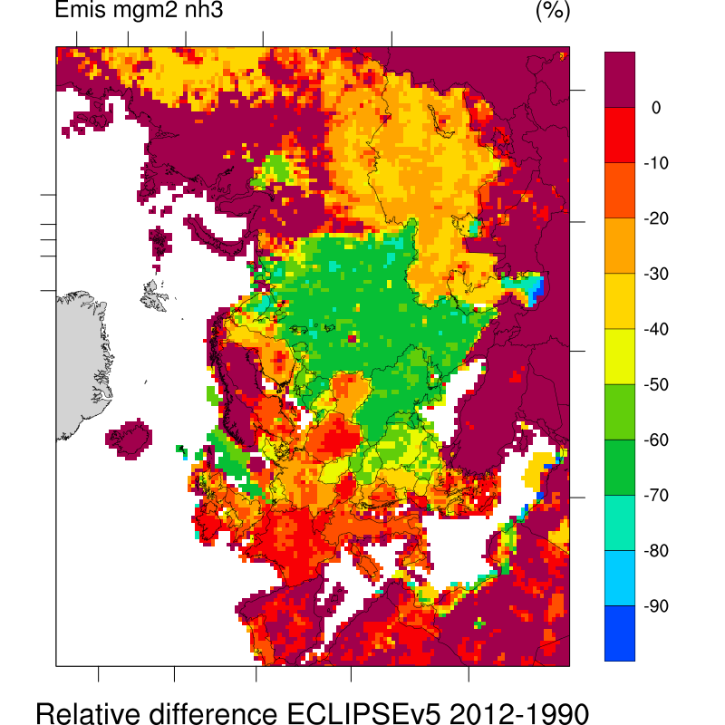
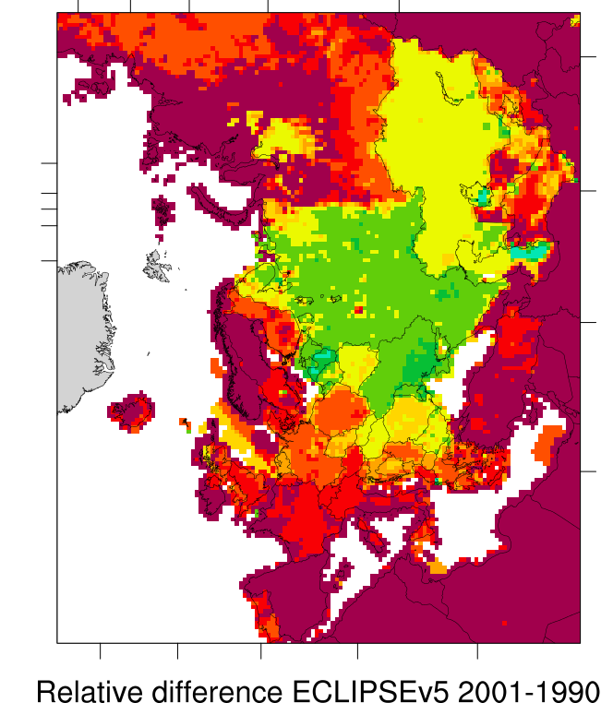
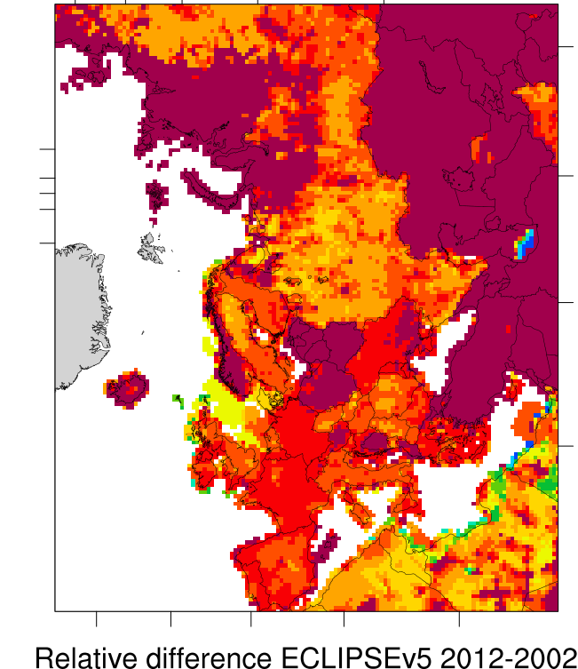
Trends in reduced nitrogen
NH3 emissions
% change

Slide 17
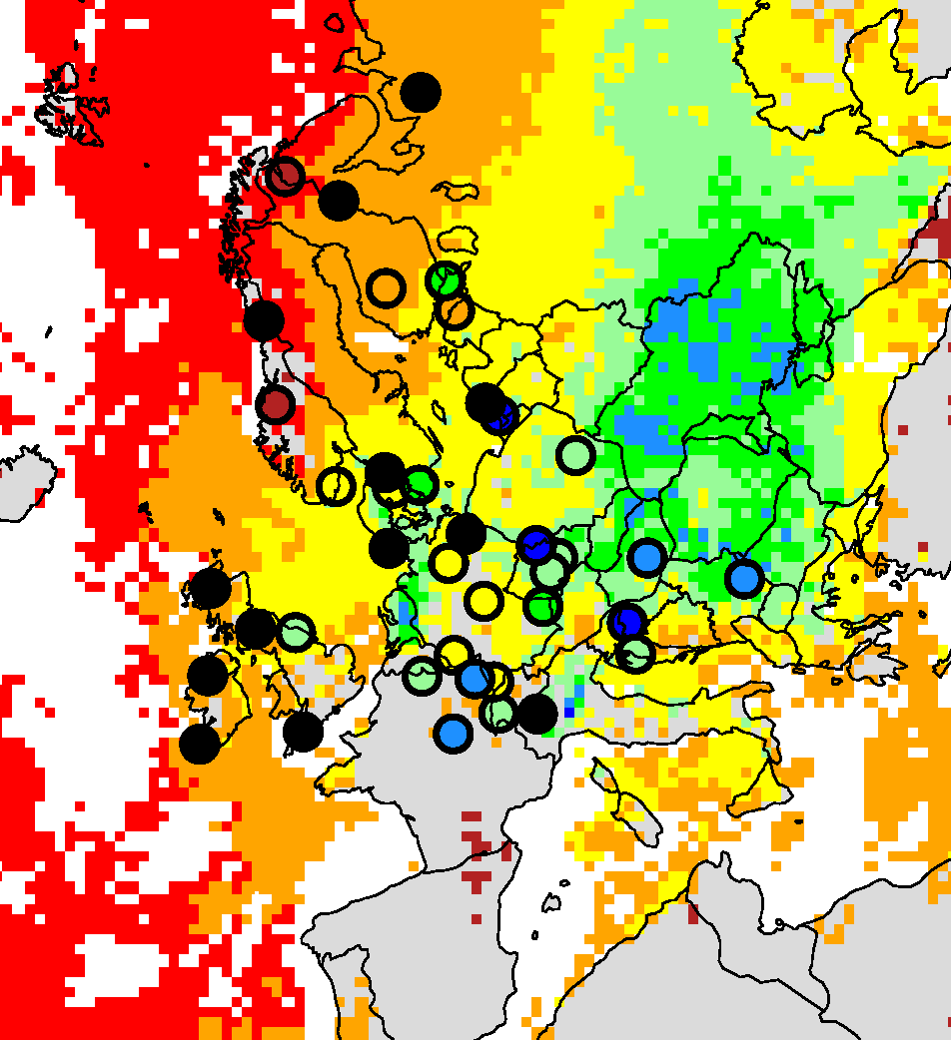

Red. N in precip (Sen slope: mgN/l per year), 1990-2012
Field: model
Circle: obs
Black circle: not significant
trend
OBS:-1.1%/yr
MOD:-1.2%/yr

Slide 18
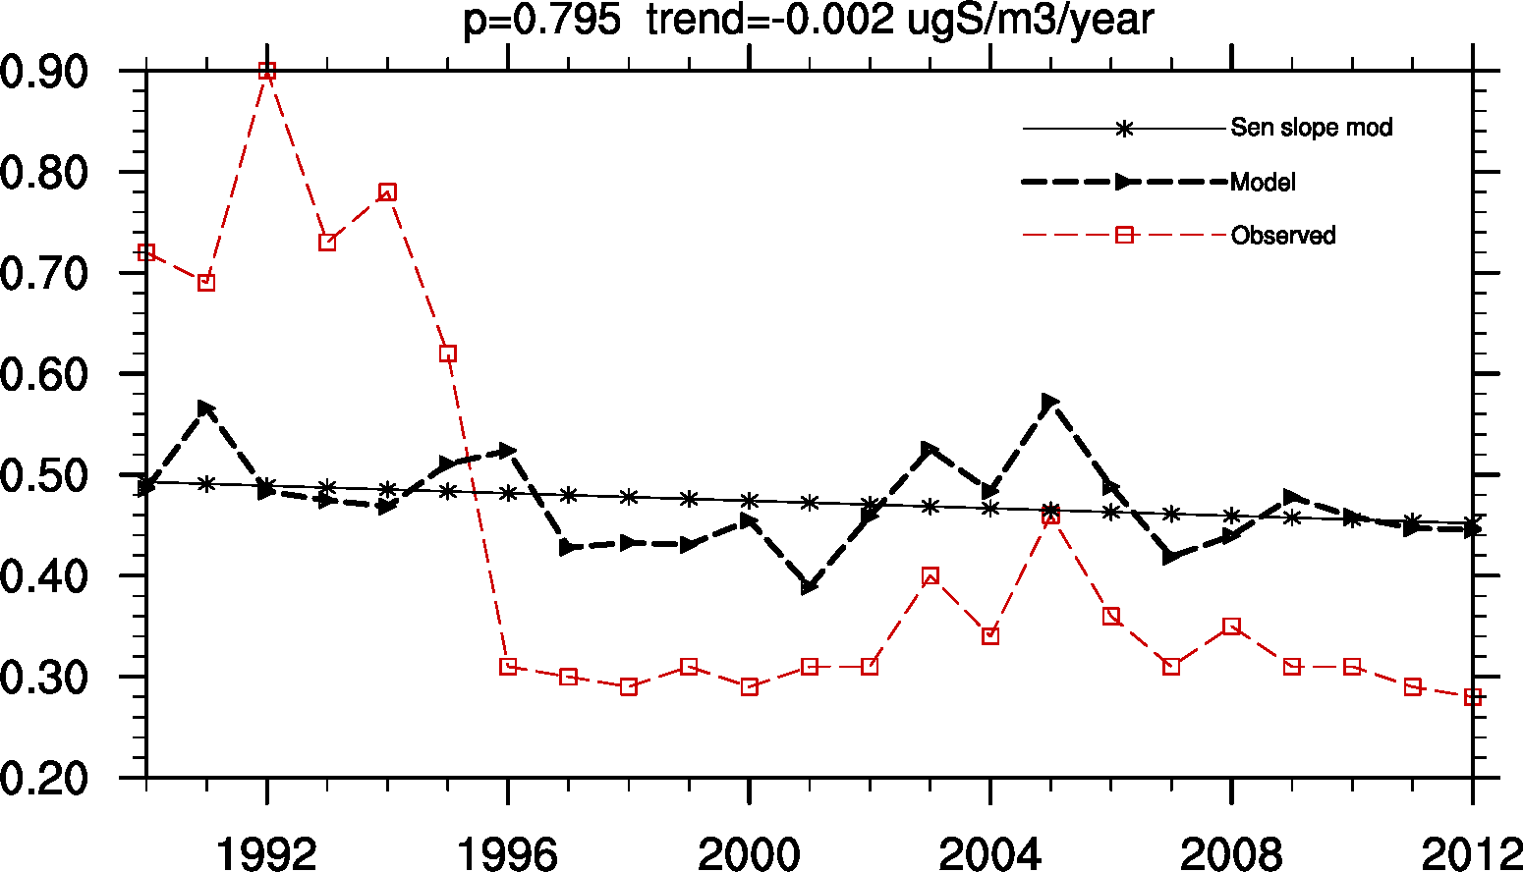
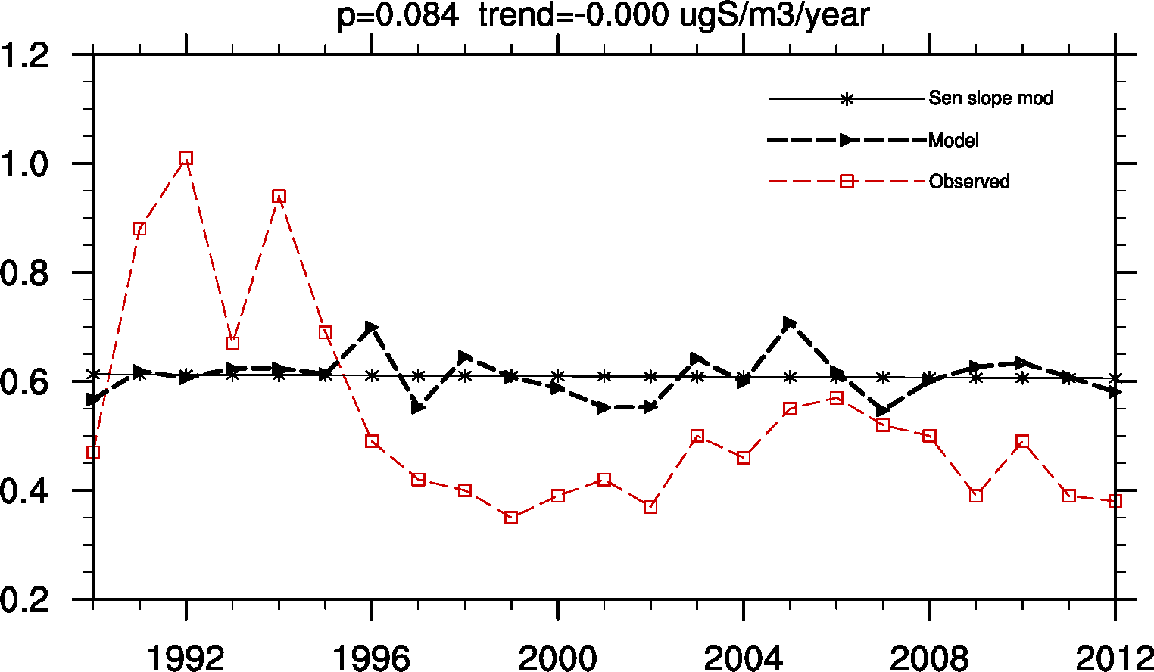
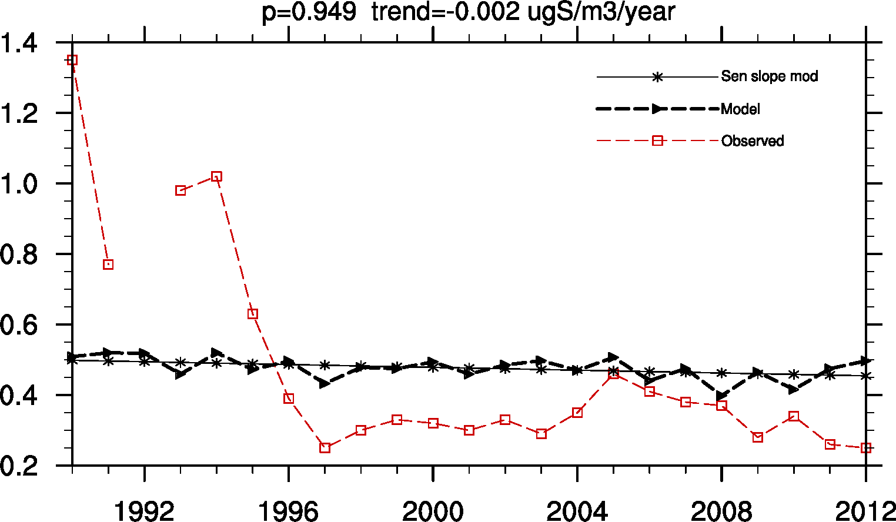
French sites, why so large trend?
FR08
FR09
FR10

Slide 19
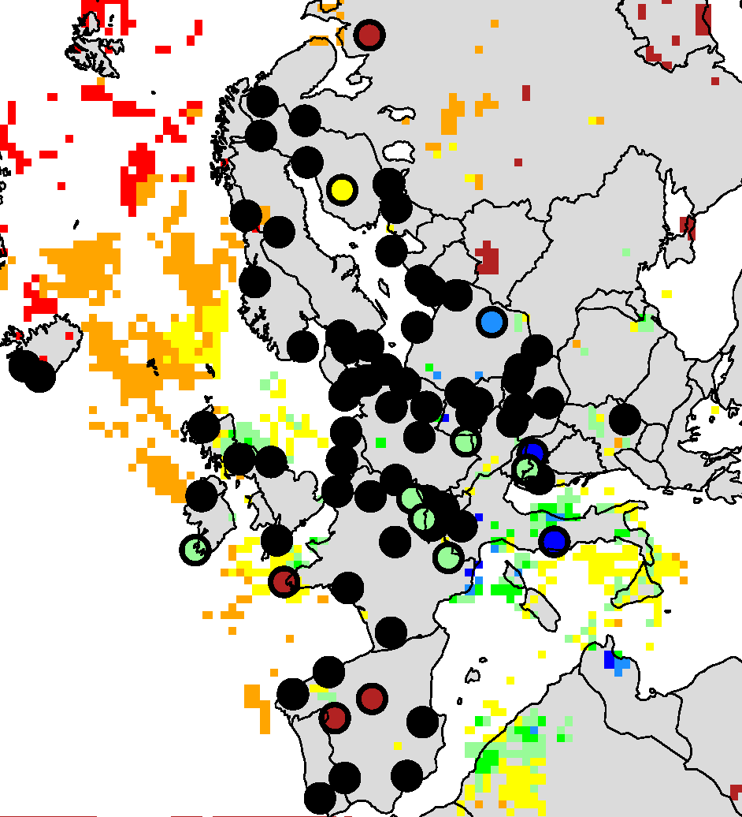

Red. N in precip (Sen slope: mgN/l per year), 2002-2012
Field: model
(colour only if significant)
Circle: obs
Black circle: not significant
trend

Slide 20
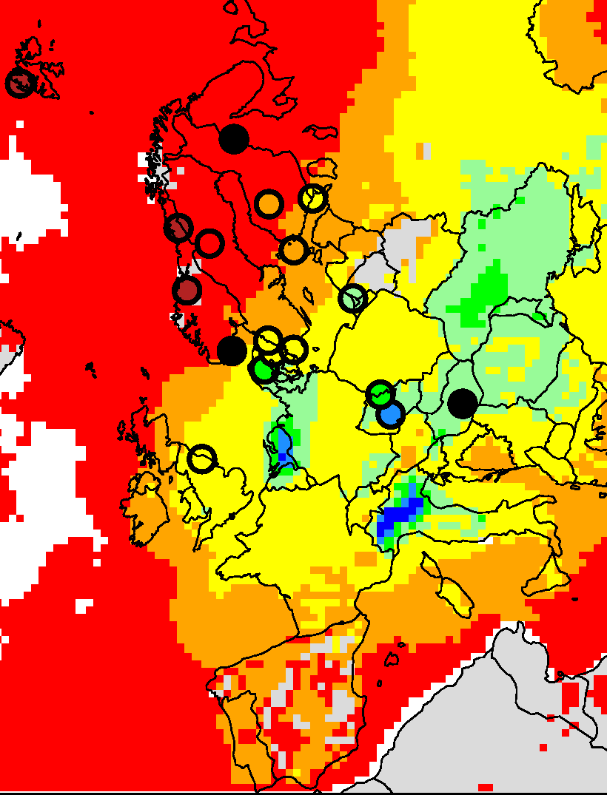

Sum NH3+NH4+ (Sen slope: mgN/l per year), 1990-2012

Slide 21
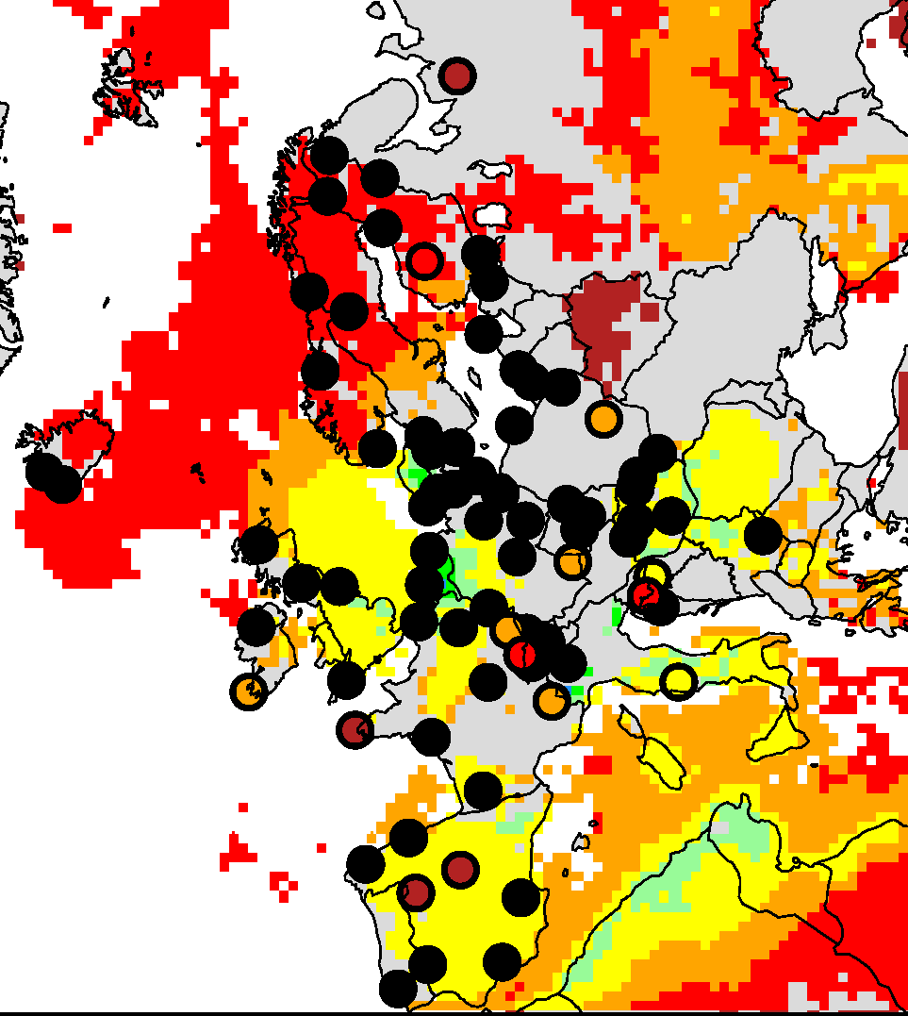
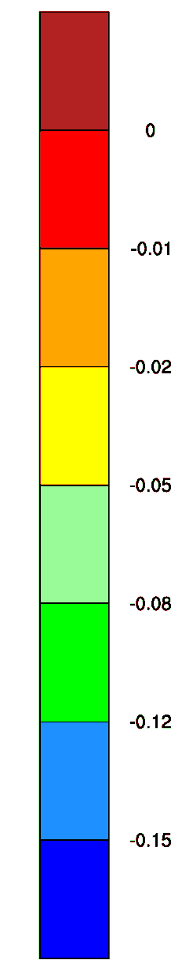
Sum NH3+NH4+ (Sen slope: mgN/l per year), 2002-2012

Slide 22
Summary, reduced nitrogen
Red. N in precip: good agreement. Some obs. sites show larger trend than the model
NH3+NH4+ in air: good agreement
Difficult to see trends for the shorther periods

Slide 23
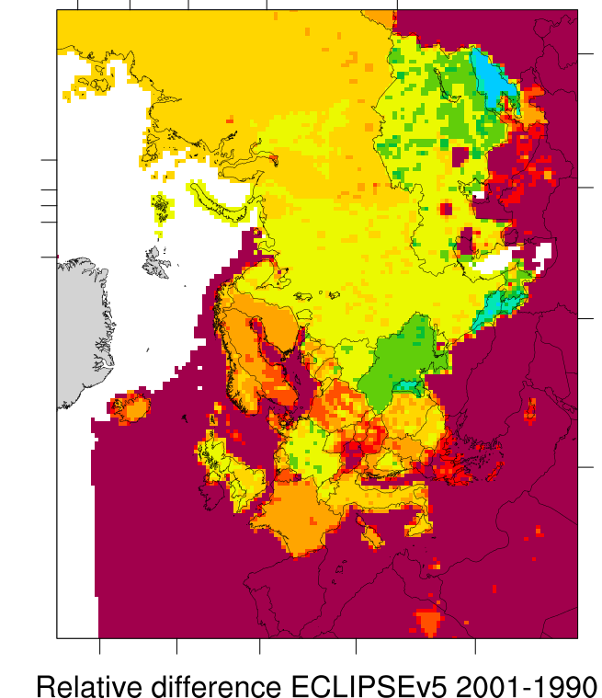
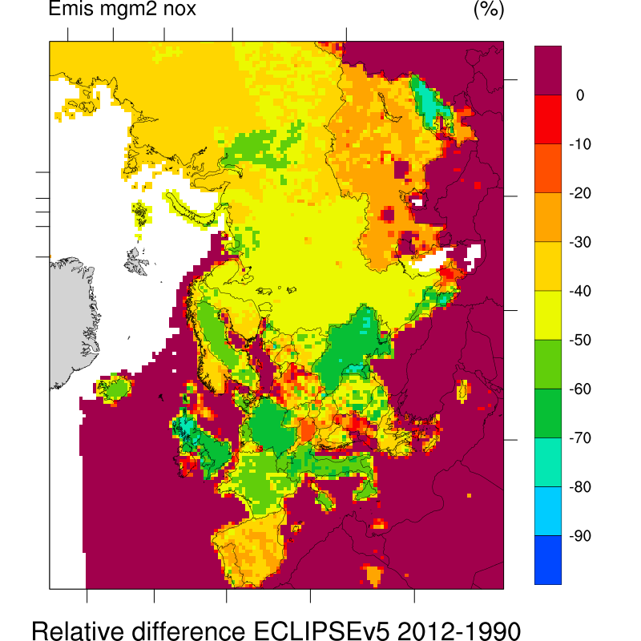
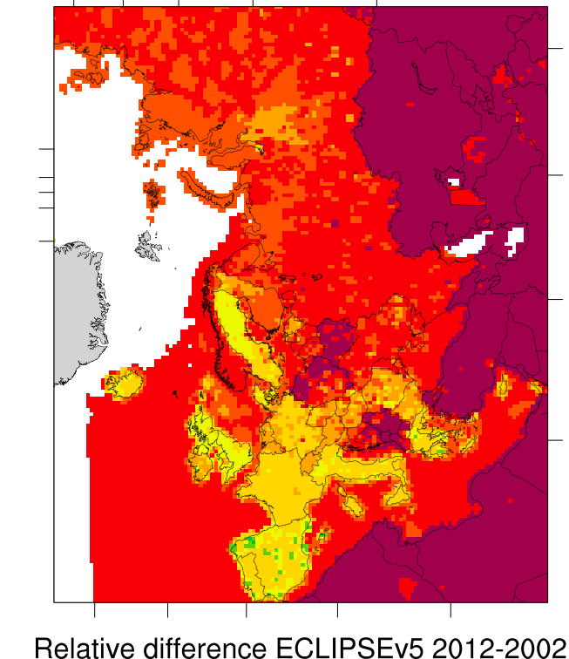
Changes in NOx emissions (%), 1990-2012

Slide 24
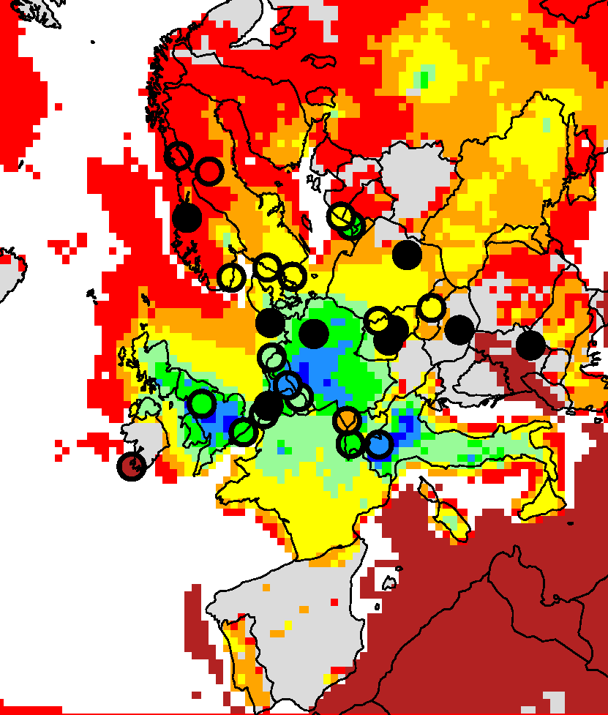
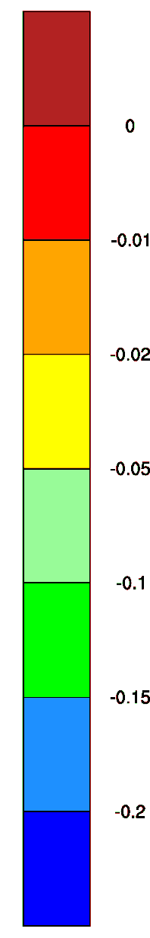
NO₂ (Sen slope: ugN/m3 per year), 1990-2012
OBS:-1.2%/yr
MOD:-1.4%/yr

Slide 25
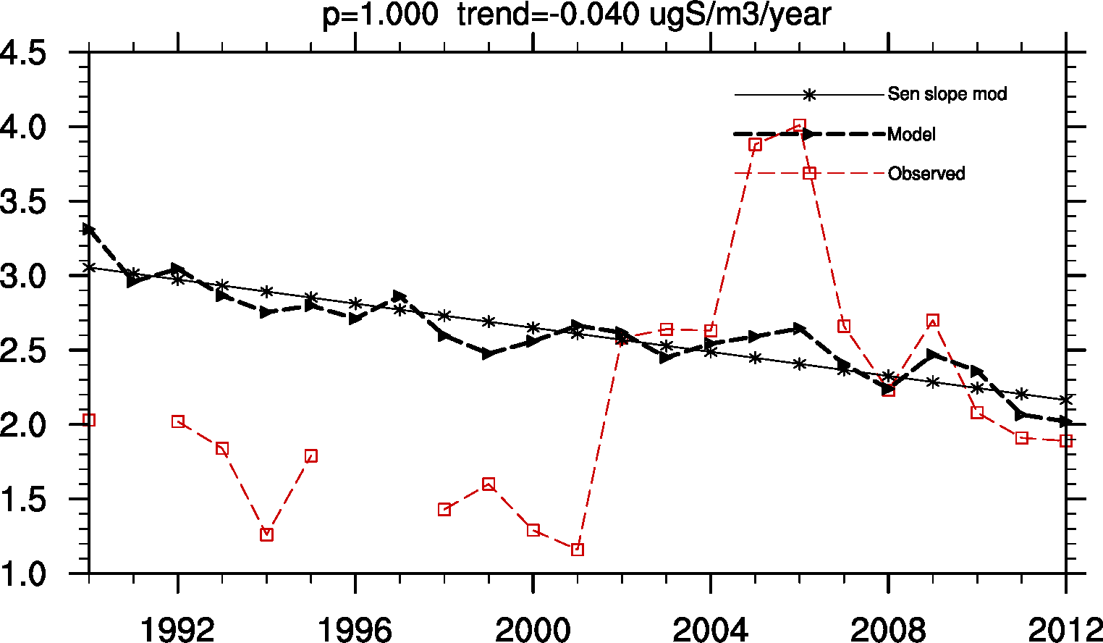
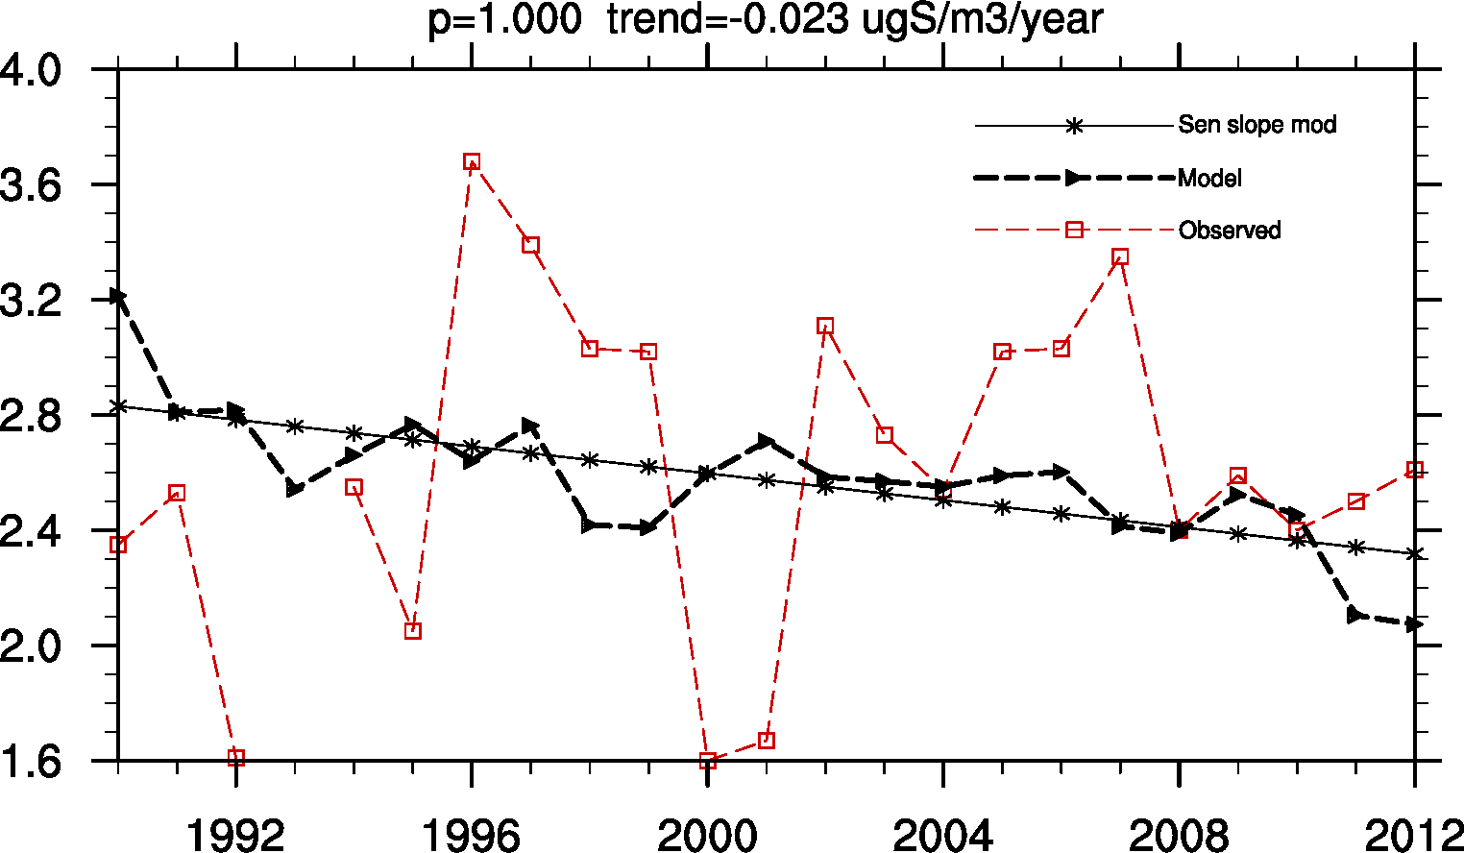
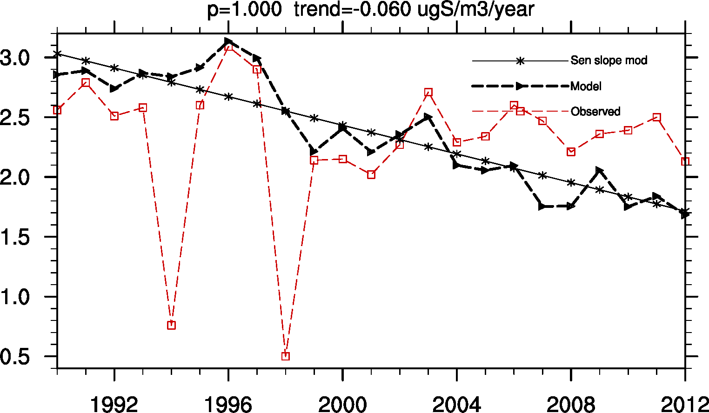
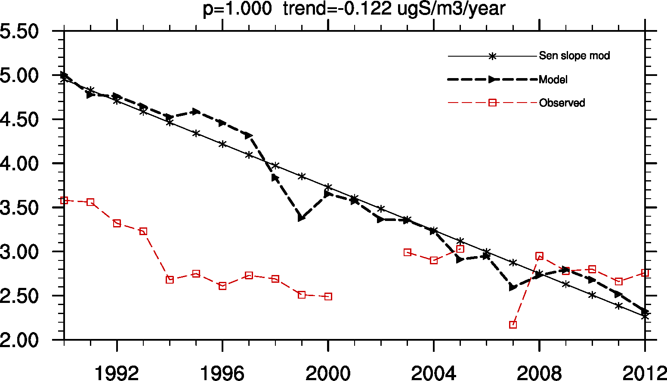
Why so many non-signifiant sites?
4 Examples
CZ01
CZ03
DE01
DE03

Slide 26
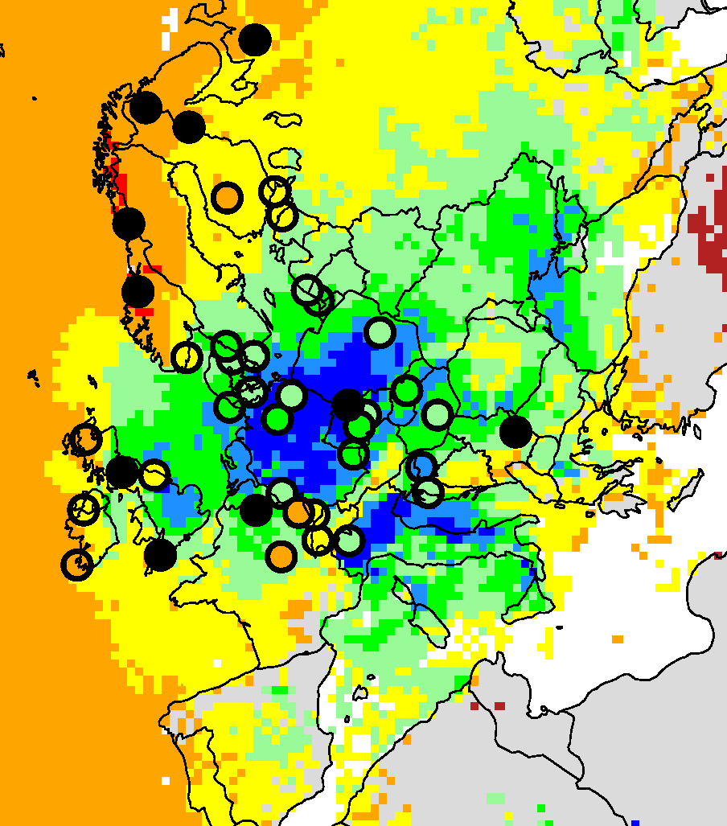

Ox. N in precip (Sen slope: mgN/l per year), 1990-2012
OBS:-1.3%/yr
MOD:-2.2%/yr
Obs lower than
Model in early 90’s for e.g. DE,PL,FR
DE 1990: 10% lower in EMEP
PL 1990: 20% lower in EMEP

Slide 27
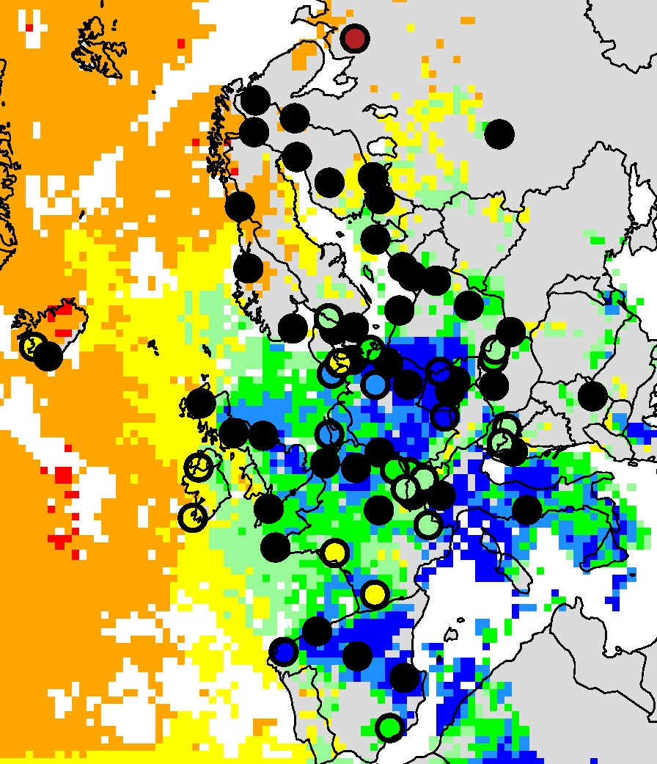

Ox. N in precip (Sen slope: mgN/l per year), 2002-2012

Slide 28
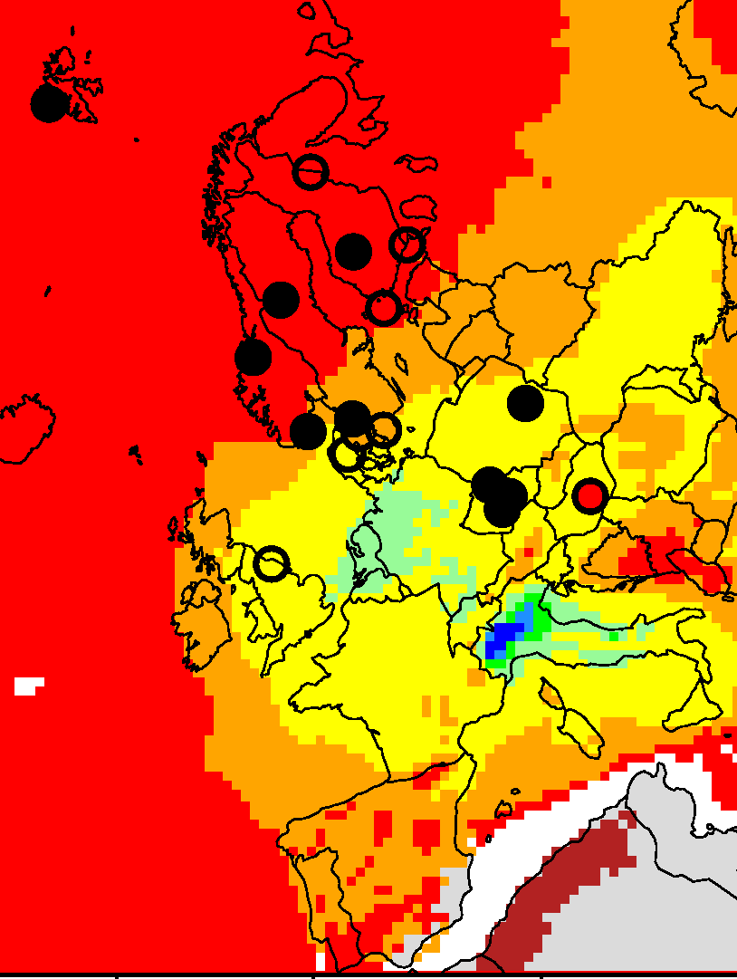
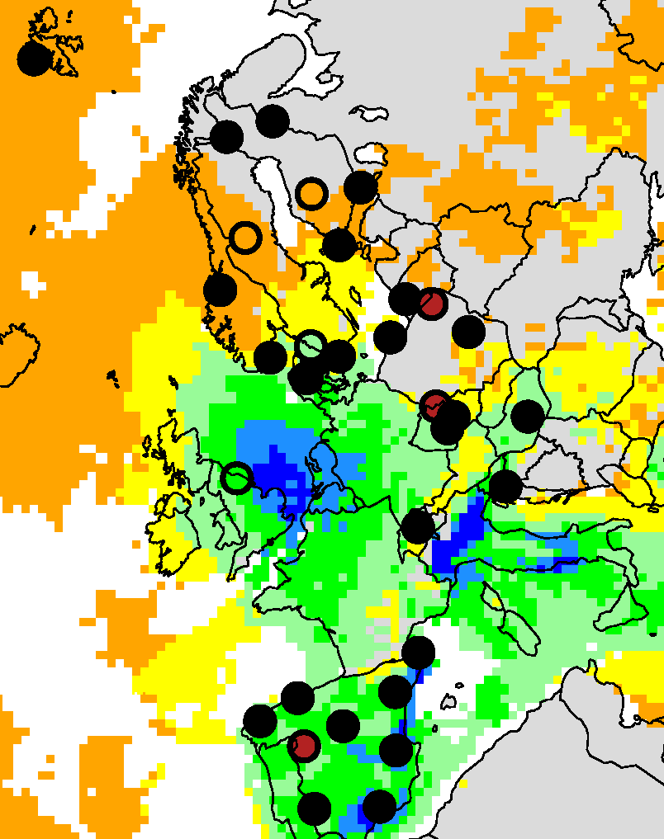


NO3+HNO3 (Sen slope: ugN/m3 per year)
1990-2012
2002-2012

Slide 29
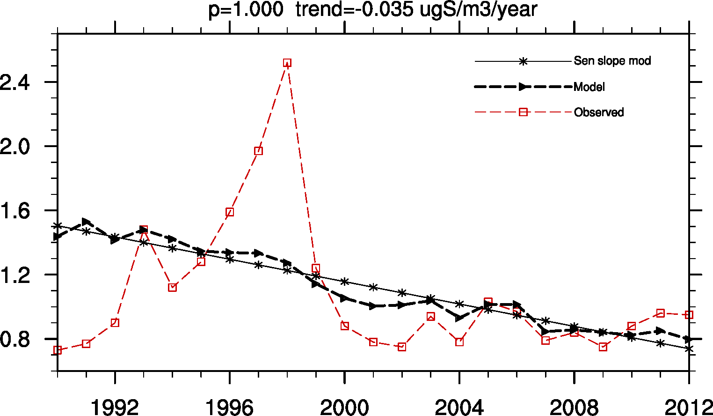
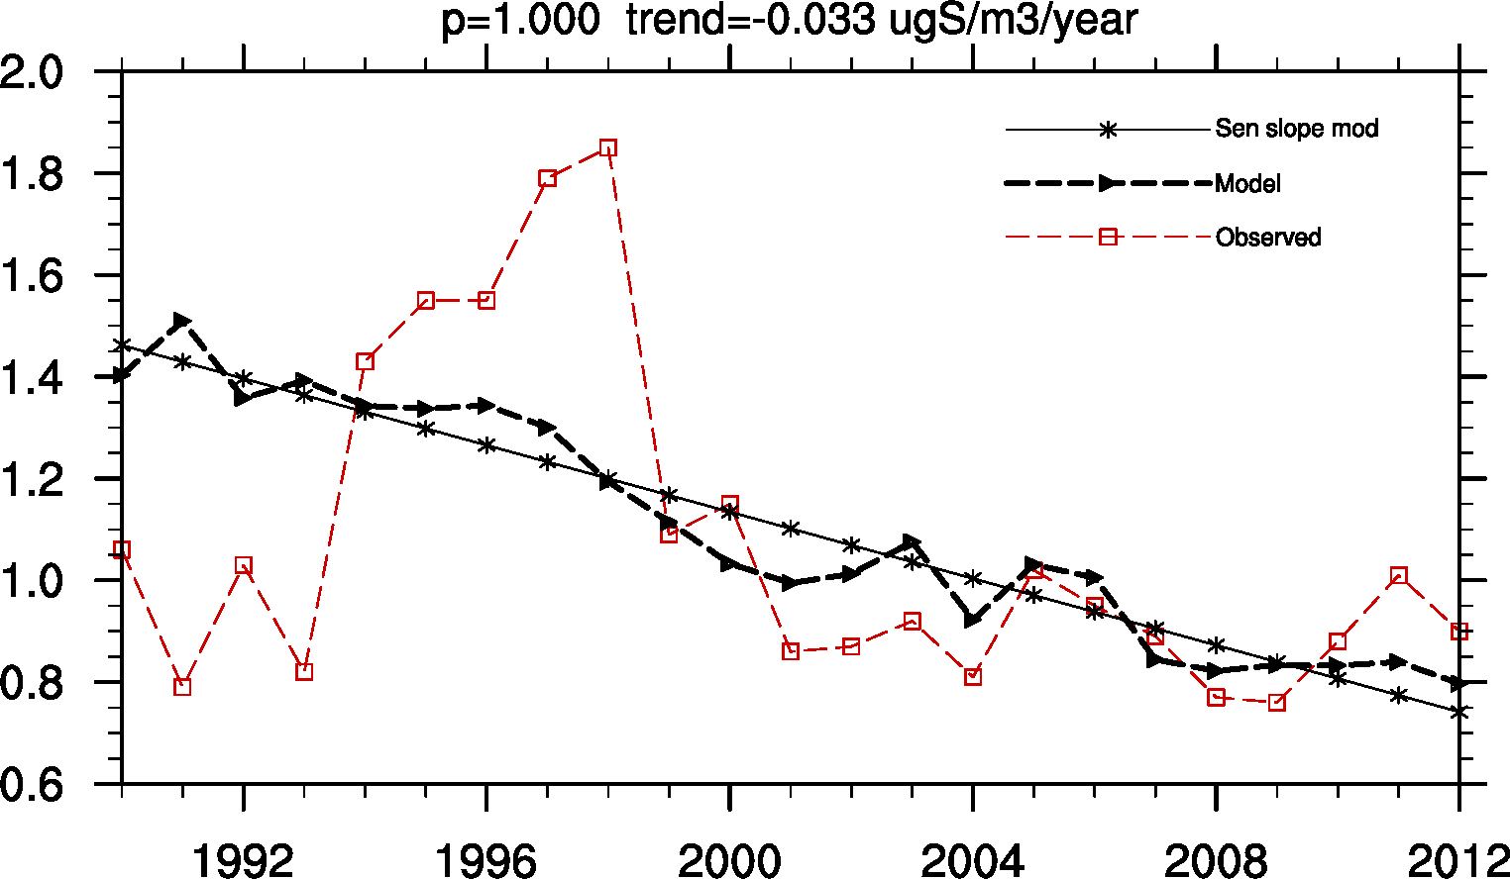
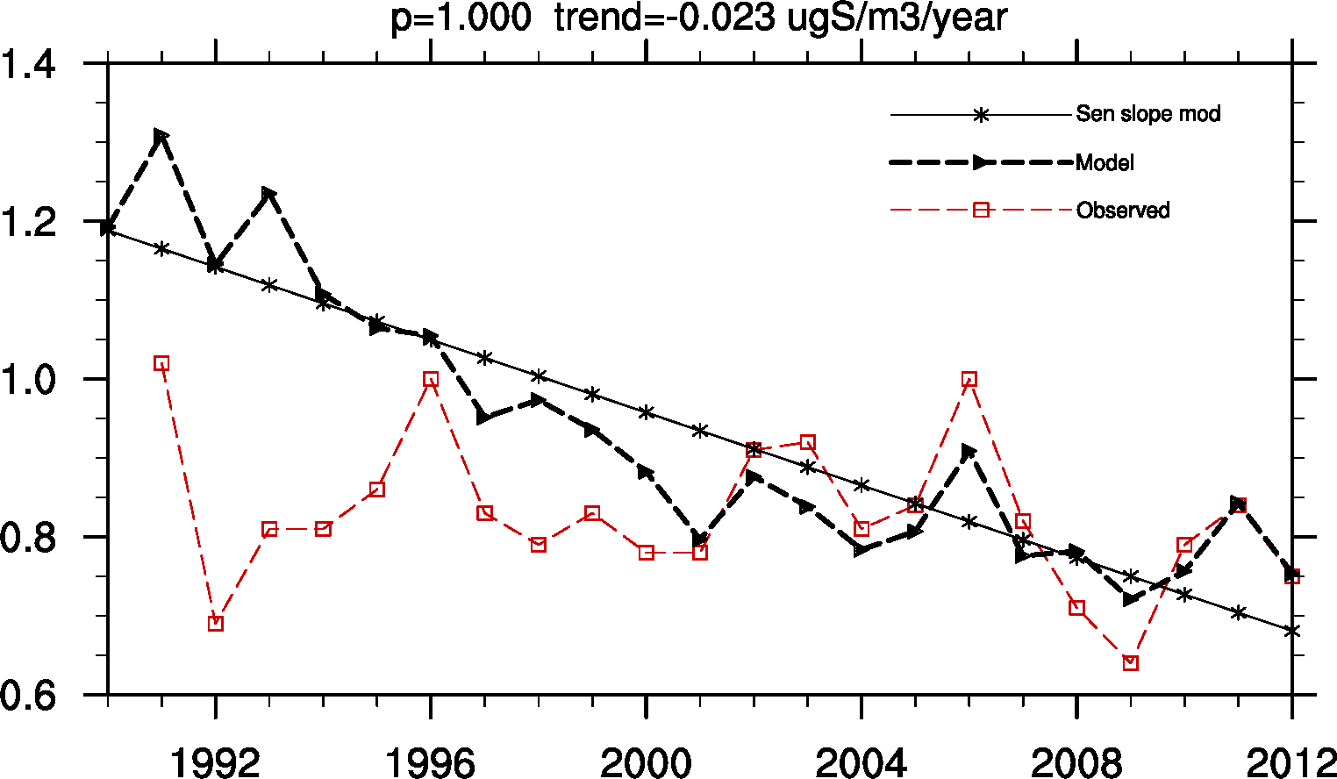
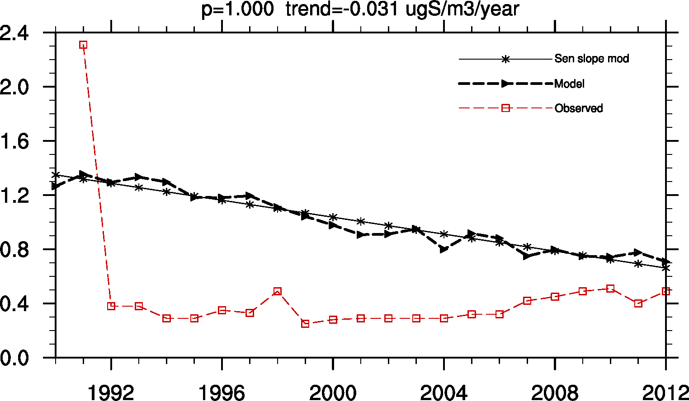
Some examples of ‘non-significant’ sites
CZ01
CZ03
PL02
PL03

Slide 30
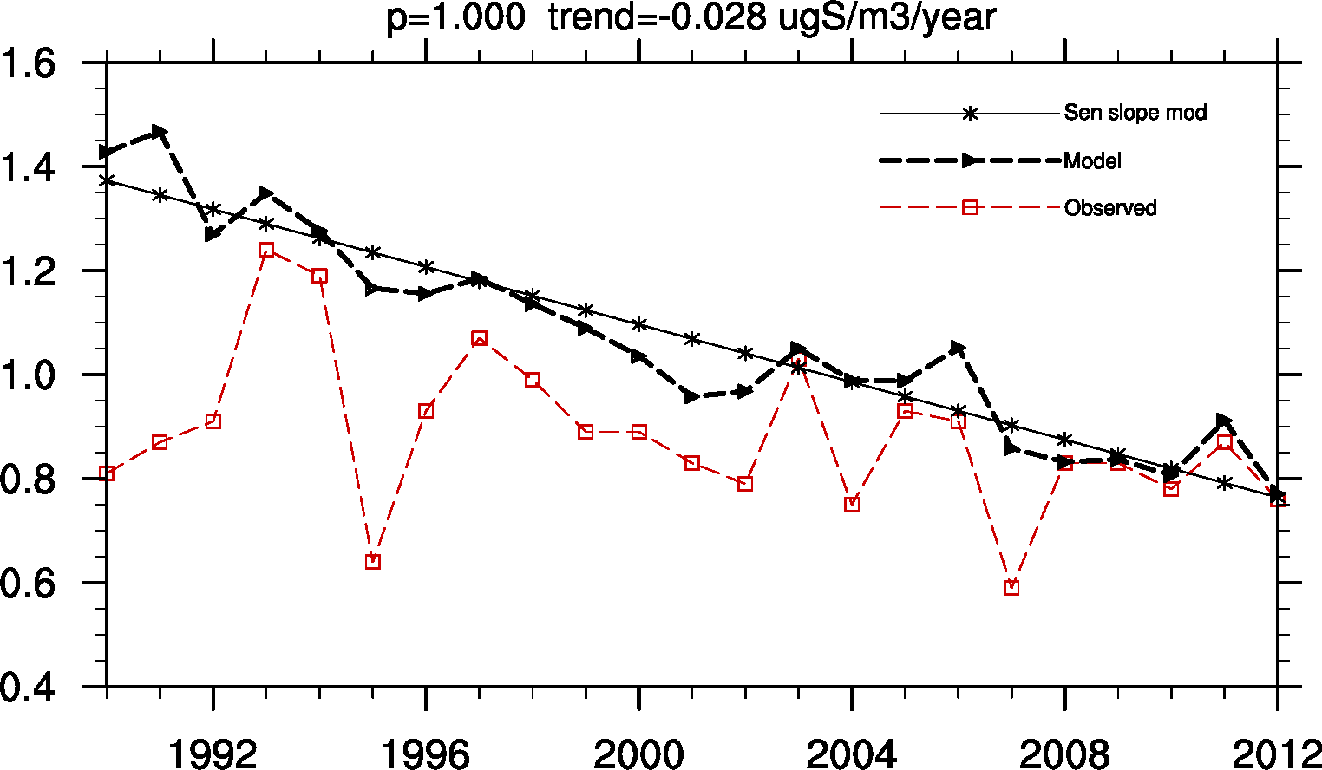
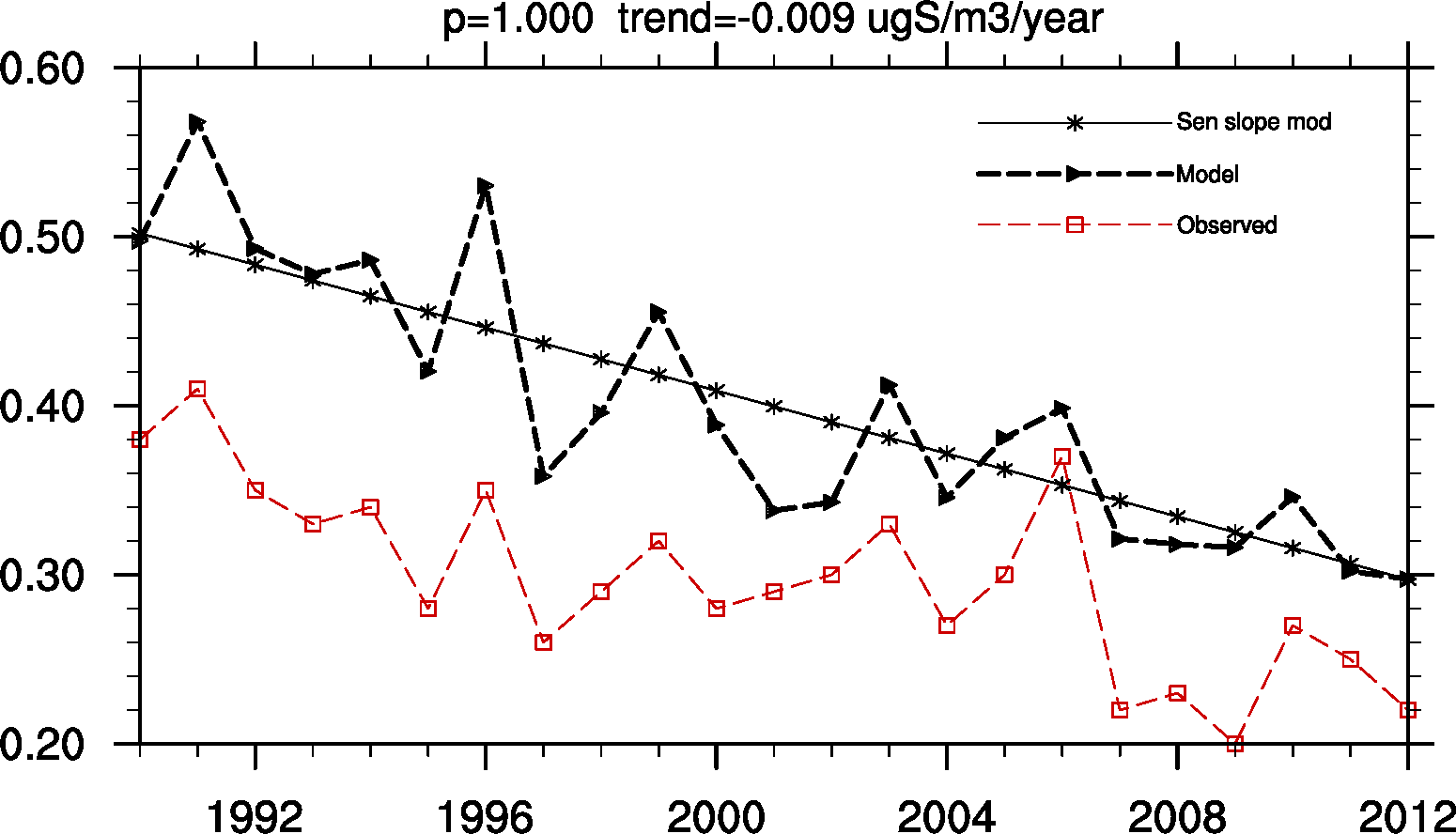
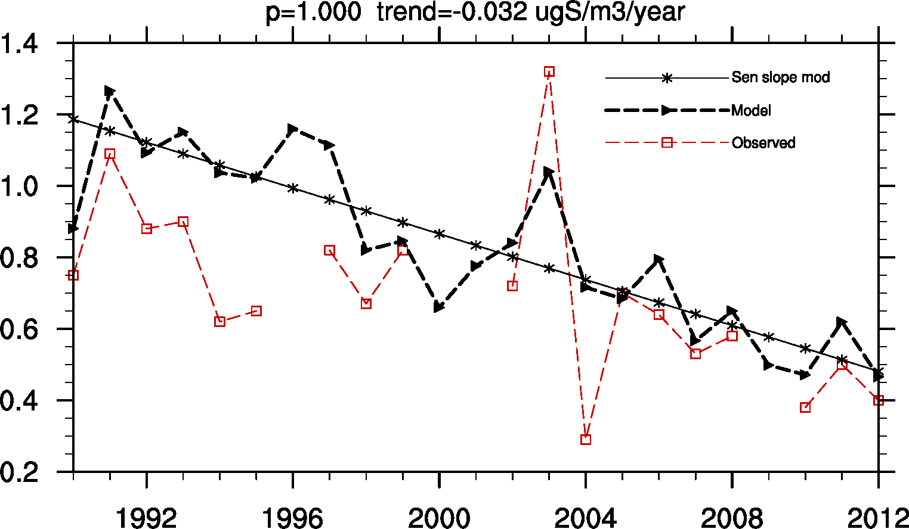
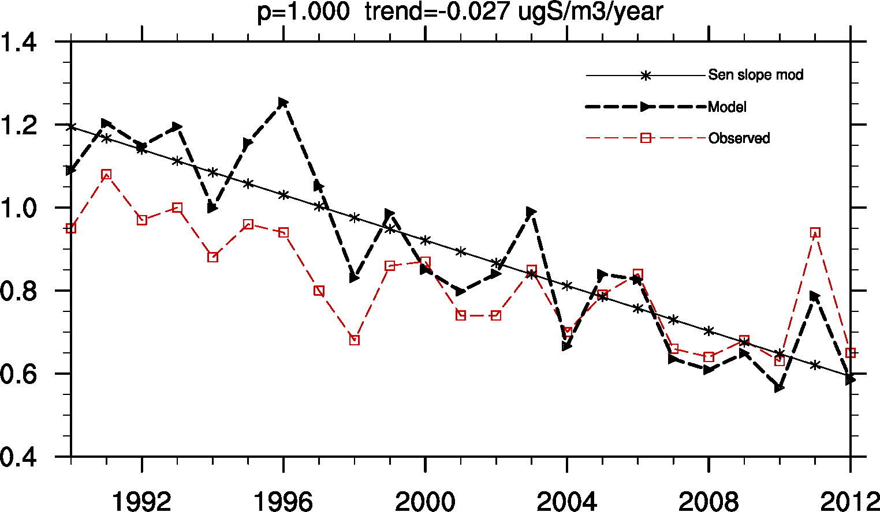
Some examples of ‘significant’ sites
HU02
FI17
GB14
DK08

Slide 31
Summary oxidized nitrogen
NO2 trend – good agreement between model and obs
Ox. N conc in precip: tendency for larger trend in model
NO3+HNO3 in air: few sites have trends (more in model)
Difficult to see any trends for shorther period

Slide 32
Conclusions
Benchmark set needs another ‘washing’
Overall consistent picture of emissions, observations, models, Trend S>ox. N> red. N
Less variability in model -> more often ‘see trends’
Largest discrepancies for oxidized N
Lots of interesting add-on studies: importance of sectors, BC’s, meteorological variability, forest fires…

Slide 33
Ozone
95th percentile of daily max ozone
Median (50th percentile) daily max ozone (apr-sept)
1990-2012, 1990-2001, 2002-2012

Slide 34



Trends P95 (dmax O₃)
1990-2001
1990-2012
Model: reductions all periods whole EMEP land domain, strongest central Europe (NL, DE, CH, IT, S-UK.
Measurements: Many non-significant trends (particularly the shorter periods). Nearly all trends negative.
2002-2012

Slide 35


Significance level of 80%, P95
1990-2001
2002-2012

Slide 36


Trends P50 (dmax O₃ Apr-Sep)
1990-2001
2002-2012
Note different scale!
P50(dmax (O₃ summer)) → less significant trends then the P95 metric
Model: reductions W-Europe 2002-2012, only sign. central-Europe 1990-2001
Measurements: Many non-significant trends. Fair agreement N-Europe 2002-2012

Slide 37
Time series 1990-2012 (p95(O₃dmax))
some AT sites
CH and CZ sites
Central European sites (AT, CH, CZ):
Sign. decline at most sites (10-15 ppb/23 years)
Modelled trend stronger than observed
Best agreement at CZ sites

Slide 38
Time series 1990-2012 (p95(O₃dmax))
some GB sites
some DE sites
GB sites: Good agreement mod/obs-trend at many sites in S-GB
DE sites: Mod/obs correlates, but modelled trend stronger than observed
For all sites: Larger spread in observed values than modelled. Also larger variation between stations in the observations than the model

Slide 39
Preliminary conclusions O₃
Somewhat mixed results for ozone:
Decline in most ozone metrics (observed and modelled), time periods and regions
Model gives stronger reductions than measured
Model → significant reductions over large areas
Measurements → negative, but non-significant at most sites
Reasons?
Too short time periods for robust trends (90-’01 and 02-12)?
Maximum of O3 background around 1998-2000 ->makes it harder to find trend 1990-2012
Model/obs agreement varies between regions. Best in GB, NL.
Systematic overestimation of modelled trends vs measurements? Why?
Stratospheric contribution
Closer inspection needed for:
site representativeness, processes, ozone metrics, boundaries ...

Slide 40


Slide 41

NH3 emissions
abs. change

Slide 42

Changes in NOx emissions, 1990-2012

